Slide 1
Firing Event Detection & Classification on Drosophila Sensillum Recording Data
Tommy Peng, Varun Rao

Slide 2
Outline
Background
Results
-Detection of Spikes
-Oscillatory Behavior
Discussion/Limitations

Slide 3
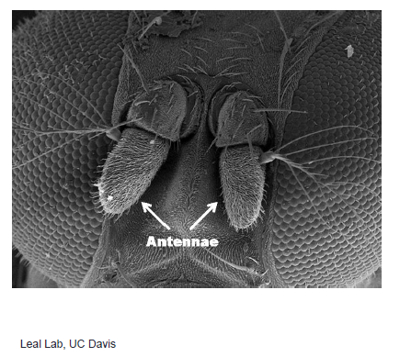
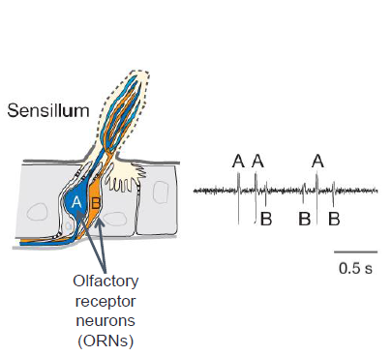
Background
Drosophila - Common Fruit Fly

Slide 4
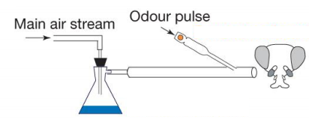
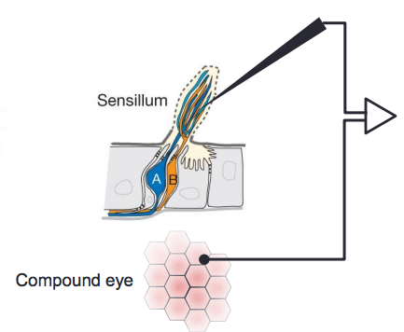
Background - Experimental Setup
MAp - Pure methyl acetate
MHp - Pure methyl hexanoate
Sampling rate 15000 Hz
60 second recordings
Odor stimulus applied after 10 seconds for 1 second

Slide 5
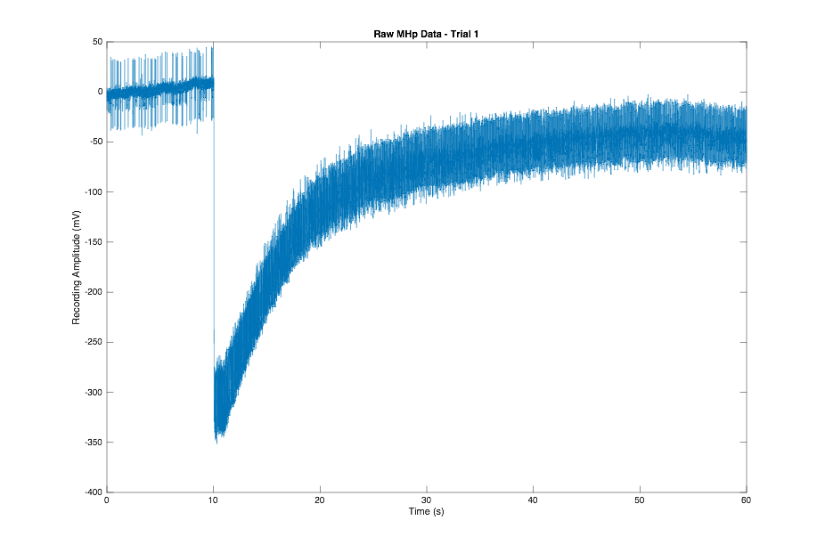
Raw Data - MHp

Slide 6
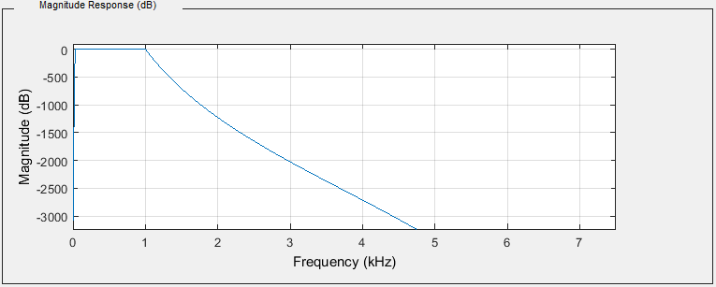
Butterworth Filter - Bandpass
Passband: 30 to 1000 Hz, Order: 372.

Slide 7
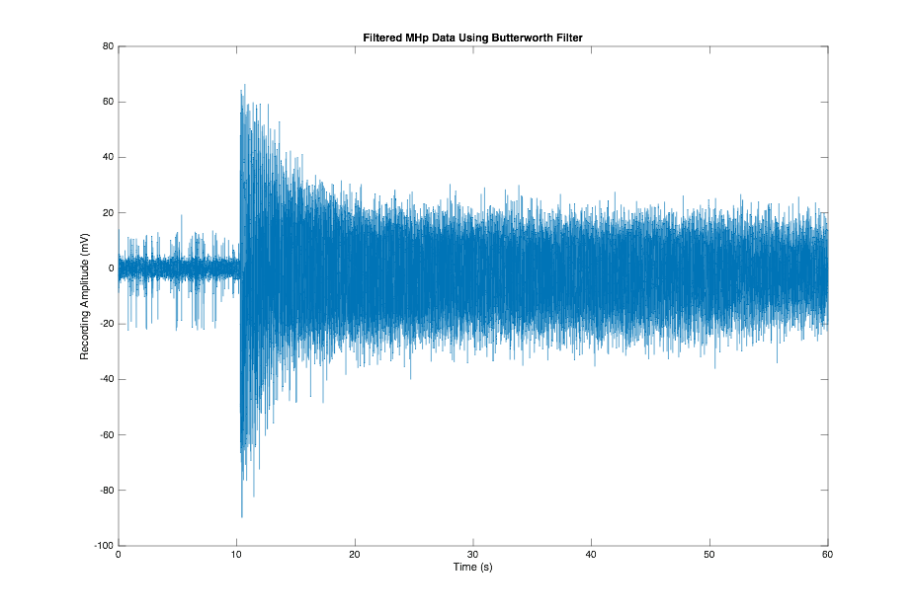
Filtered Data - Whole

Slide 8
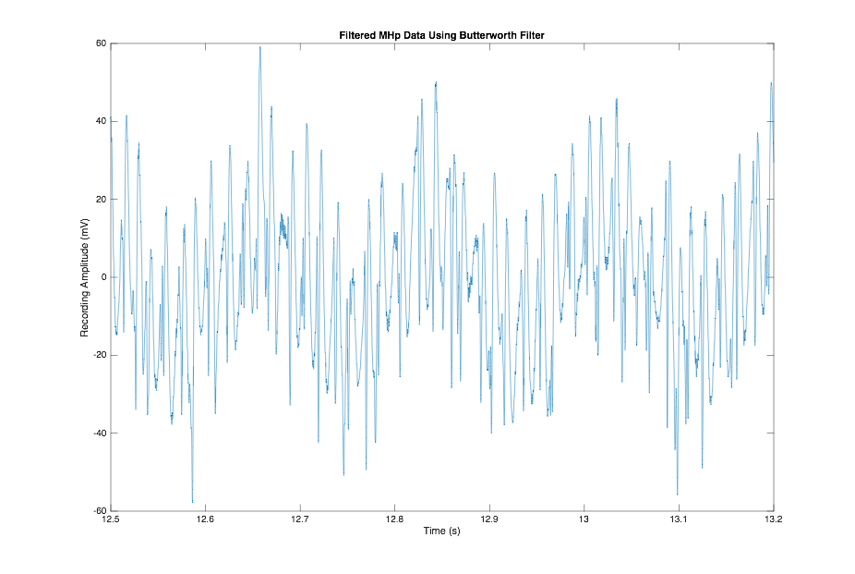
Filtered Data - Section

Slide 9
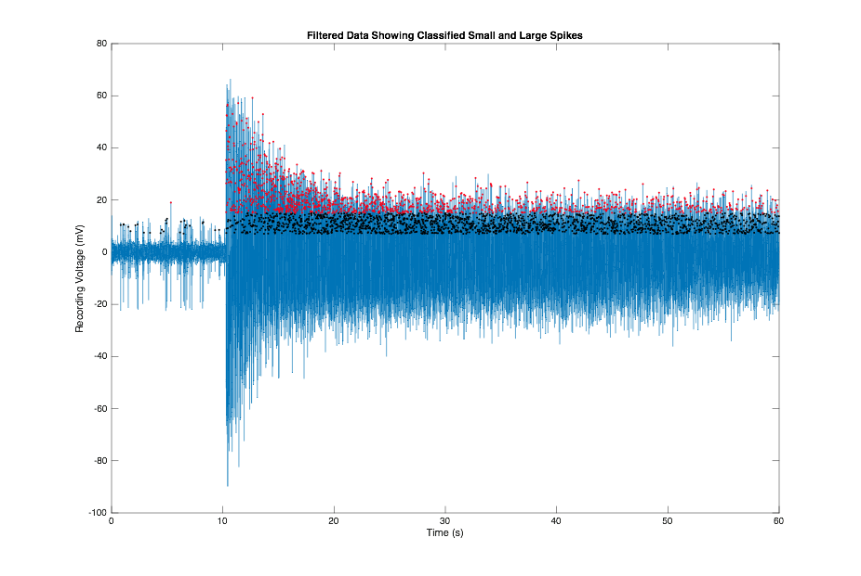
Classified Small and Large Spikes - Trial 1

Slide 10
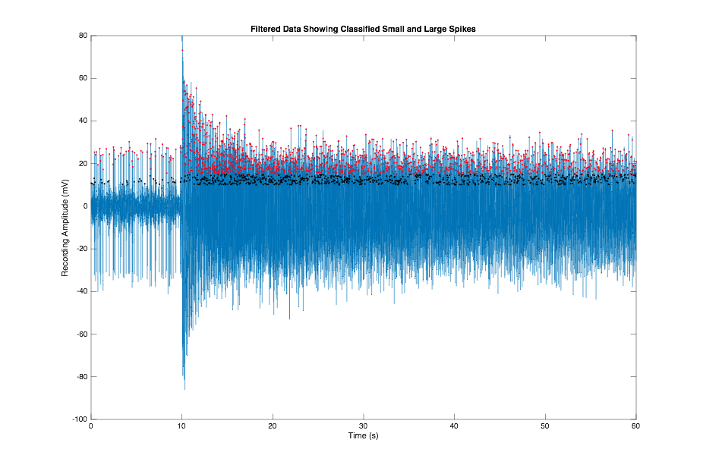
Classified Small and Large Spikes - Trial 4

Slide 11
Filtered Data - Section

Slide 12
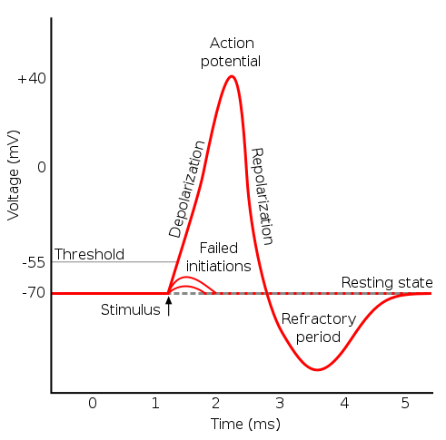
Features of Action Potential

Slide 13
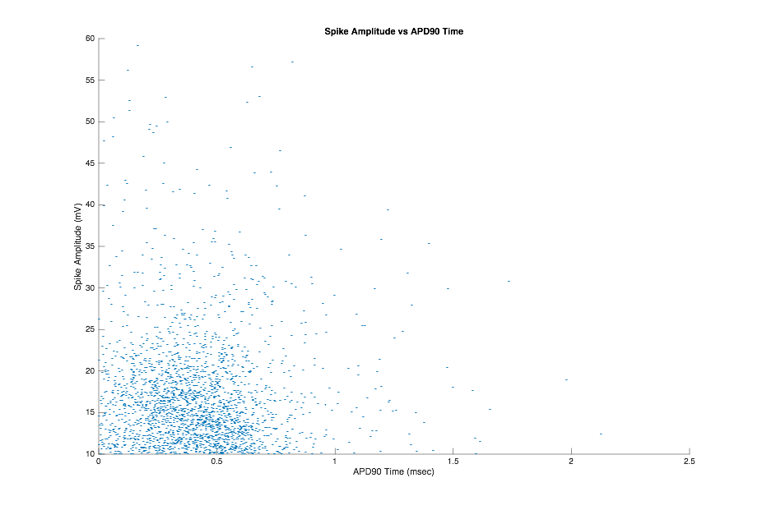
Spike Amplitude and APD90 - Trial 1

Slide 14

Spike Amplitude and APD90 - Trial 4

Slide 15
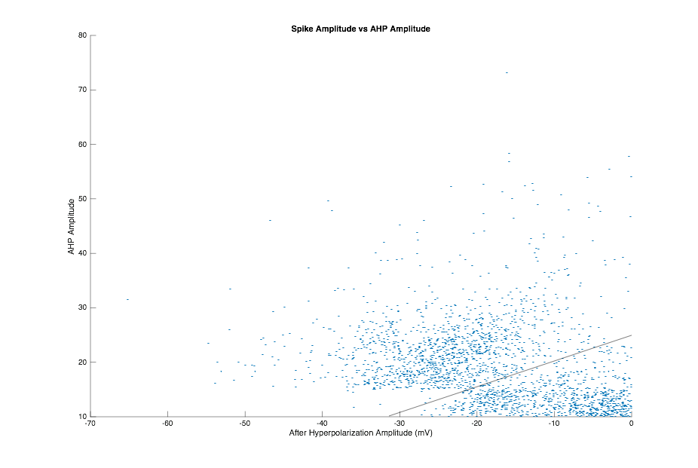
Spike Amplitude and AHP Amplitude - Trial 4

Slide 16
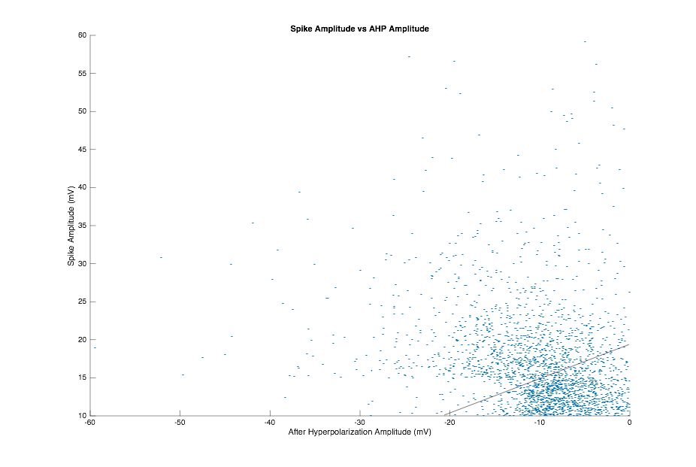
Spike Amplitude and AHP Amplitude - Trial 1

Slide 17
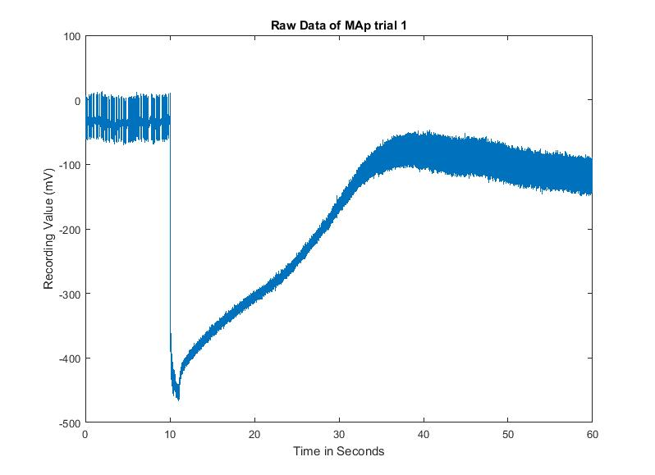
Raw Data - MAp

Slide 18
Butterworth Filter - Bandpass
Passband: 30 to 1000 Hz, Order: 372.

Slide 19
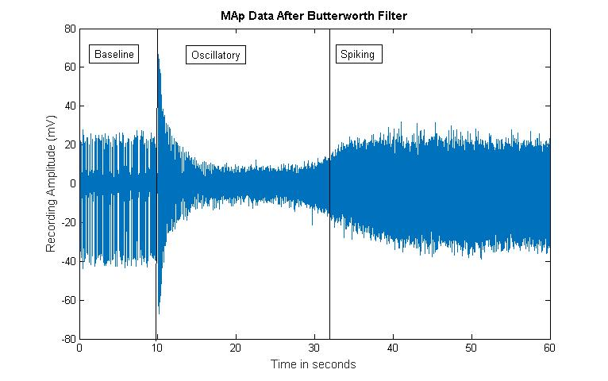
Filtered Data - Whole

Slide 20
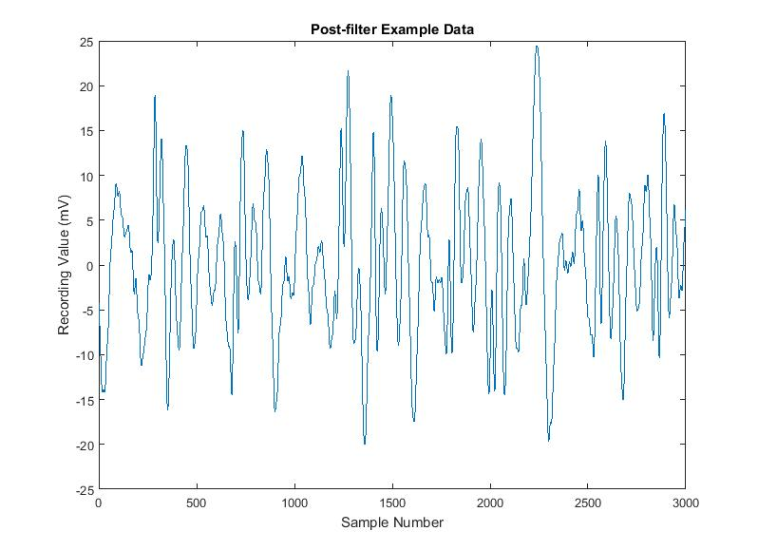
Filtered Data - Segment Example

Slide 21
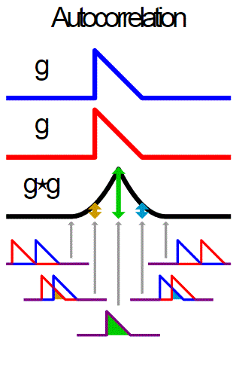
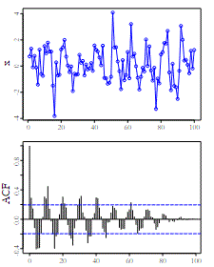
Oscillatory - Autocorrelation

Slide 22
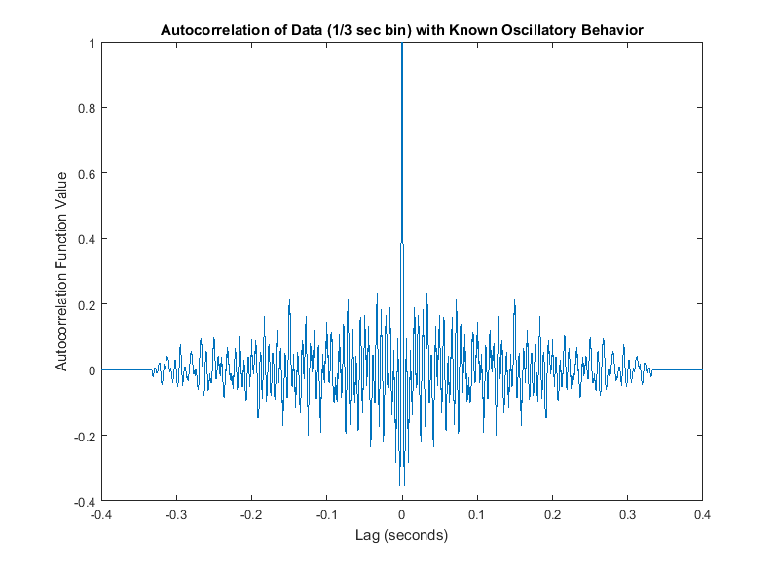
Oscillatory - Autocorrelation

Slide 23
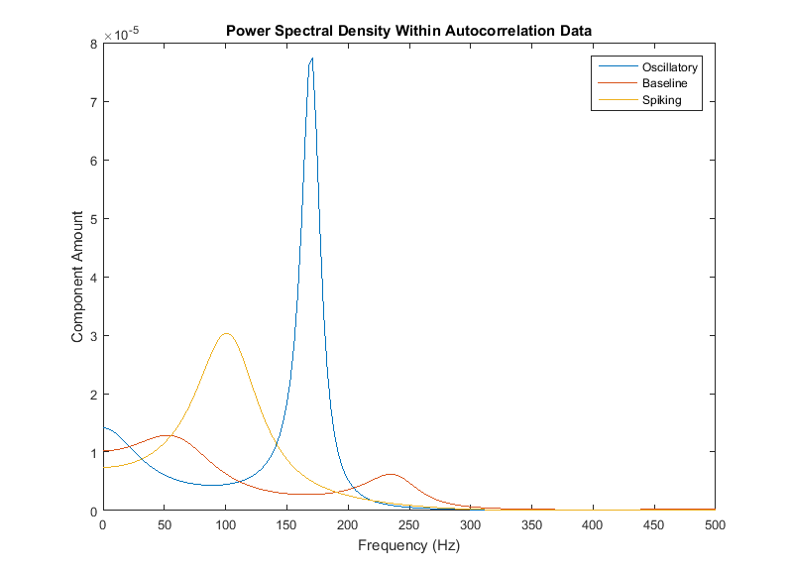
Oscillatory - Power Spectral Density

Slide 24
Oscillatory - Classification Approach
Power is different for Oscillatory and Spiking behaviors.
Frequency of peak in power is different for Oscillatory and Spiking behaviors.
Use 5000 sample bins, among small samples of known behavior (OSC or NON-OSC), look at the PSD of the autocorrelation within the bin.
Find maximum peak and frequency of peak within the PSD of autocorrelation, to create two classes (OSC or NON-OSC) of PSD maximums.
Use Mean Square Errors (MSE) to find a separation line.

Slide 25
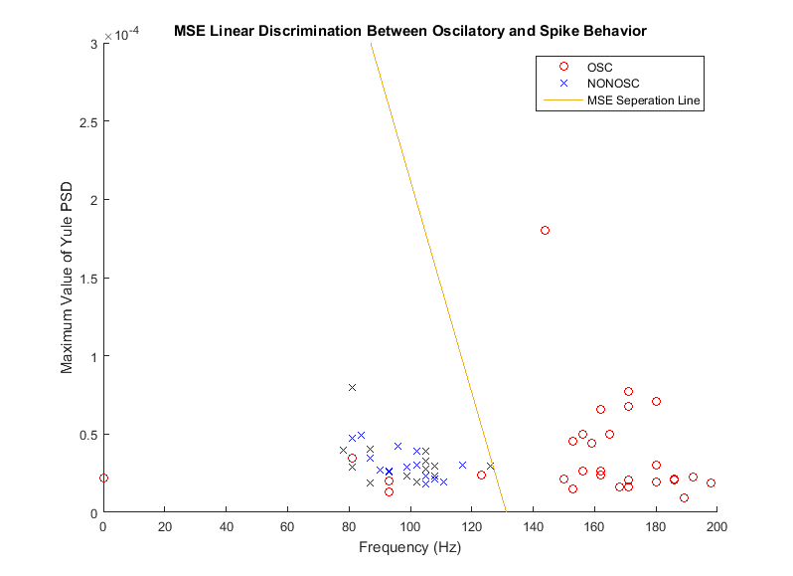
Oscillatory - Linear Discriminant Analysis

Slide 26
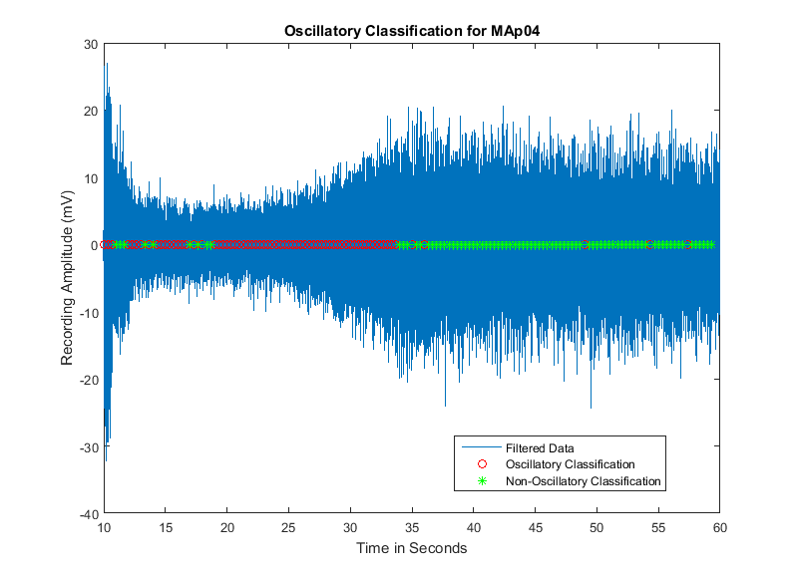
Oscillatory - Classification Result

Slide 27
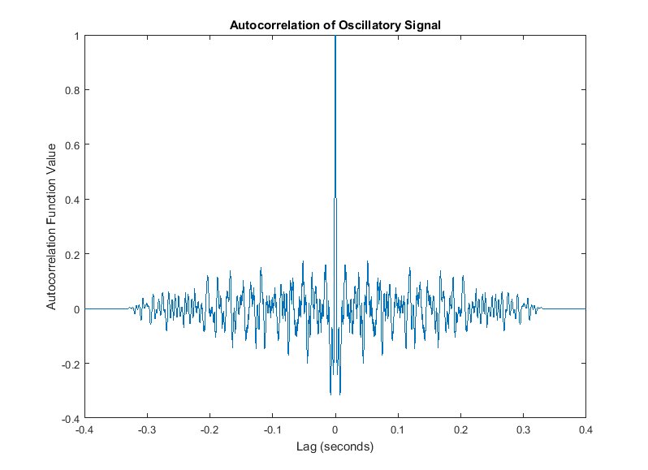
Oscillatory - Detection of Frequency

Slide 28
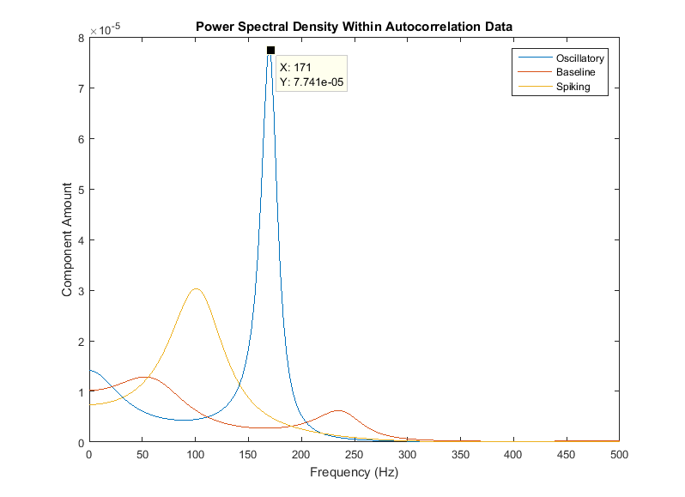
Oscillatory - Detection of Frequency

Slide 29
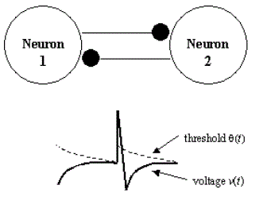
Oscillatory Modelling
Used two-neuron oscillator adaptive threshold model with leaky integrate-and-fire units, similar to that discussed in homework 1.
Attempted to achieve similar temporal domain and frequency domain behavior.

Slide 30
Oscillatory Modelling
Lowered synaptic reversal potential from -15mV to -35mV.
Lowered threshold time constant from 50ms to 22ms.
Created new action potential amplitude for neuron A and B to be 40mV and 20mV respectively. This is through observations on MAp data.
Step in input, increase from 1.1nA to 1.5nA for input to neuron A.
Added normally distributed random noise to the data.

Slide 31
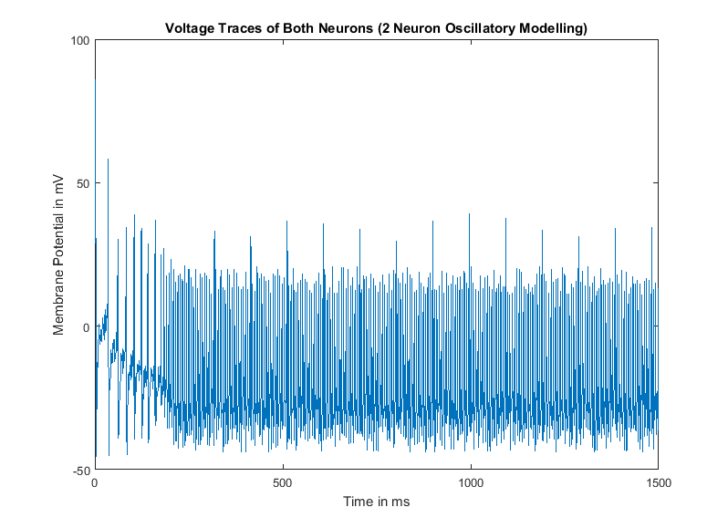
Temporal Modelling

Slide 32
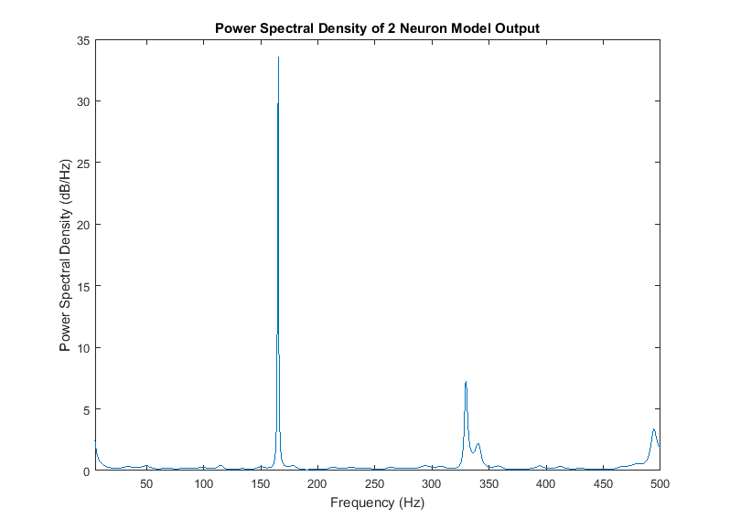
Power Spectral Density of Model Data

Slide 33
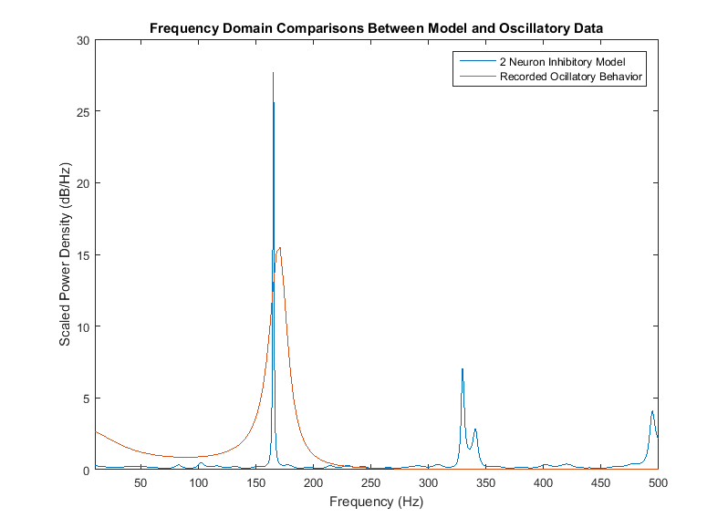
Comparison To Recorded Spectrum

Slide 34
Oscillatory Modelling Comments
Able to create some baseline behavior.
Able to create somewhat oscillating behavior after baseline behavior.
Unable to create spiking behavior again after oscillations.
Frequency domain analysis looks similar compared to that of recorded data.
Frequency analysis of modelled data has peaks at harmonics of the first peak frequency, this is a limitation of the model.

Slide 35
Discussion
Spike Sorting
Amplitudes can be used to characterize big and small
Other features ensure accurate classification
MSE of amplitudes and other features separates into two classes
Oscillatory Sorting
Autocorrelation function characterizes sub-threshold oscillations
Power spectral densities lead to frequency classifications
Mean squared error used to separate between oscillatory and non-oscillatory behavior

Slide 36
Discussion
Oscillatory Modelling
Models the baseline spiking behavior to oscillatory behavior
Shows similar temporal aspects of the dataset
Shows same frequency spectra as the dataset

Slide 37
Limitations
Spike Sorting
Misclassification rate > 5%
PCA with amplitude and AHP amplitude show non-linearly separable classes
Oscillatory Sorting
Resulting frequency spectral observations yield non-linearly separable data, which leads to misclassifications

Slide 38
Limitations
Oscillatory Modelling
Harmonic spiking observed with frequency analysis
Lateral inhibition of action potentials is thought to be mediated through ephaptic coupling
Needs to account for non-synaptic information exchange which is missing from the two neuron inhibition model

Slide 39
Project Contributions
Tommy Peng:
1. Pre-processing of raw data
2. Oscillatory behavior detection and classification
3. Modelling of oscillatory behavior
Varun Rao:
1. Pre-processing of raw data
2. Spike detection and sorting
3. Modelling of oscillatory behavior

Slide 40
References
"Methyl Hexanoate 106-70-7." Methyl Hexanoate 106-70-7. The Good Scents Company, n.d. Web. 01 May 2016.
Brown, Judith C. "Calculation of a ‘‘narrowed’’ Autocorrelation Function." The Journal of the Acoustical Society of America J. Acoust. Soc. Am. 85.4 (1989): 1595. Web.
Couto, Africa, Mattias Alenius, and Barry J. Dickson. "Molecular, Anatomical, and Functional Organization of the Drosophila Olfactory System." Current Biology 15.17 (2005): 1535-547. Web.
O'Haver, Tom. A Pragmatic Introduction to Signal Processing. College Park: U of Maryland at College Park, 2016. Print.
Pellegrino, Maurizio, Takao Nakagawa, and Leslie B. Vosshall. "Single Sensillum Recordings in the Insects Drosophila Melanogaster and Anopheles Gambiae." Journal of Visualized Experiments JoVE 36 (2010): n. pag. Web.
Raman, Barani. Biological Neural Computation Homework Problem Set 1. N.p.: n.p., 2016. Print.
Selesnick, I.w., and C.s. Burrus. "Generalized Digital Butterworth Filter Design." IEEE Transactions on Signal Processing IEEE Trans. Signal Process. 46.6 (1998): 1688-694. Web.
Su, Chih-Ying, Karen Menuz, Johannes Reisert, and John R. Carlson. "Non-synaptic Inhibition between Grouped Neurons in an Olfactory Circuit." Nature 492.7427 (2012): 66-71. Web.
Vosshall, Leslie B., Hubert Amrein, Pavel S. Morozov, Andrey Rzhetsky, and Richard Axel. "A Spatial Map of Olfactory Receptor Expression in the Drosophila Antenna." Cell 96.5 (1999): 725-36. Web.

